Slide 1
Predictive power of GARCH
Michal Wronka, CFA, CQF

Slide 2
Agenda
Data specifications used in the analysis
Stylized facts about volatility
GARCH model definition
GJR GARCH model definition
Models’ calibration
Testing the models
Note on convergence
Backtesting
Some remarks on total variance
Final conclusions
Q & A

Slide 3
Predictive power of GARCH
01
Data specifications

Slide 4
Predictive power…
Data specifications used in analysis (1)
We are back in the world of swaps and swaptions.
A vanilla interest rate swap is an Over-the-Counter instrument in which two counterparties exchange a set of payments at a fixed rate of interest for a set of payments at floating rates
Usually when dealing with interest rate swap we are interested in a fixed rate that makes both legs balance out i.e. NPV of swap equals to zero
Pricing of a swap is model independent and it only takes a yield curve(s) to value it.

Slide 5
Predictive power…
Data specifications used in analysis (2)
In a simple case of self-discounting swap the formula for a fair swap rate is as follows:
$F\left(t\right)=F_{0,n}\left(t\right)=\frac{P\left(t,T_{0}\right)−P(t,T_{n})}{\sum_{i=1}^{n}{τ_{i}P(t,T_{i})}}$ (1)
where $P\left(t,T_{i}\right)$ are prices of zero-coupon discount bonds, priced on a curve

Slide 6
Predictive power…
Data specifications used in analysis (3)
Swaption is an option on a swap, giving its holder (buyer) a right to enter into a swap at a predetermined strike (fixed rate of a swap), at predetermined time (expiry of a swaption)
We use Black 76 model to price swaptions, which is equivalent to Black-Scholes model in Fixed Income area.
We perceive swaptions as option allowing to enter into a swap in a specific time frame e.g. 1Y x 5Y swaption is an option on a swap expiring in one year and allowing to enter into a swap that matures in 5 years from the start

Slide 7
Predictive power…
Data specifications used in analysis (4)
We will be dealing with historical data pertaining to At-the-Money Forward Swaps starting in 1Y and maturting in 5Y, and the same applies to swaptions and in particular to their implied volatilities
So our time series of underlying instruments are 1x5 forward swap fair rates and corresponding volatilities implied out of swaption prices
Swap data starts in 2007 and ends in 2023, runs through different collateralization regimes, i.e. LIBOR, OIS and SOFR

Slide 8
Predictive power of GARCH
02
Stylized facts about volatility

Slide 9
Predictive power…
Stylized facts about volatility (1)
Volatility in financial markets varies over time
Volatility exhibits high autocorrelation and this autocorrelation decays very slowly
There is a mean reversion present, i.e. volatility itself is stationary
There appear profound volatility clusters with sudden volatility shifts
Negative return/volatility correlation supports the leverage effect and can generate unconditional skewness

Slide 10
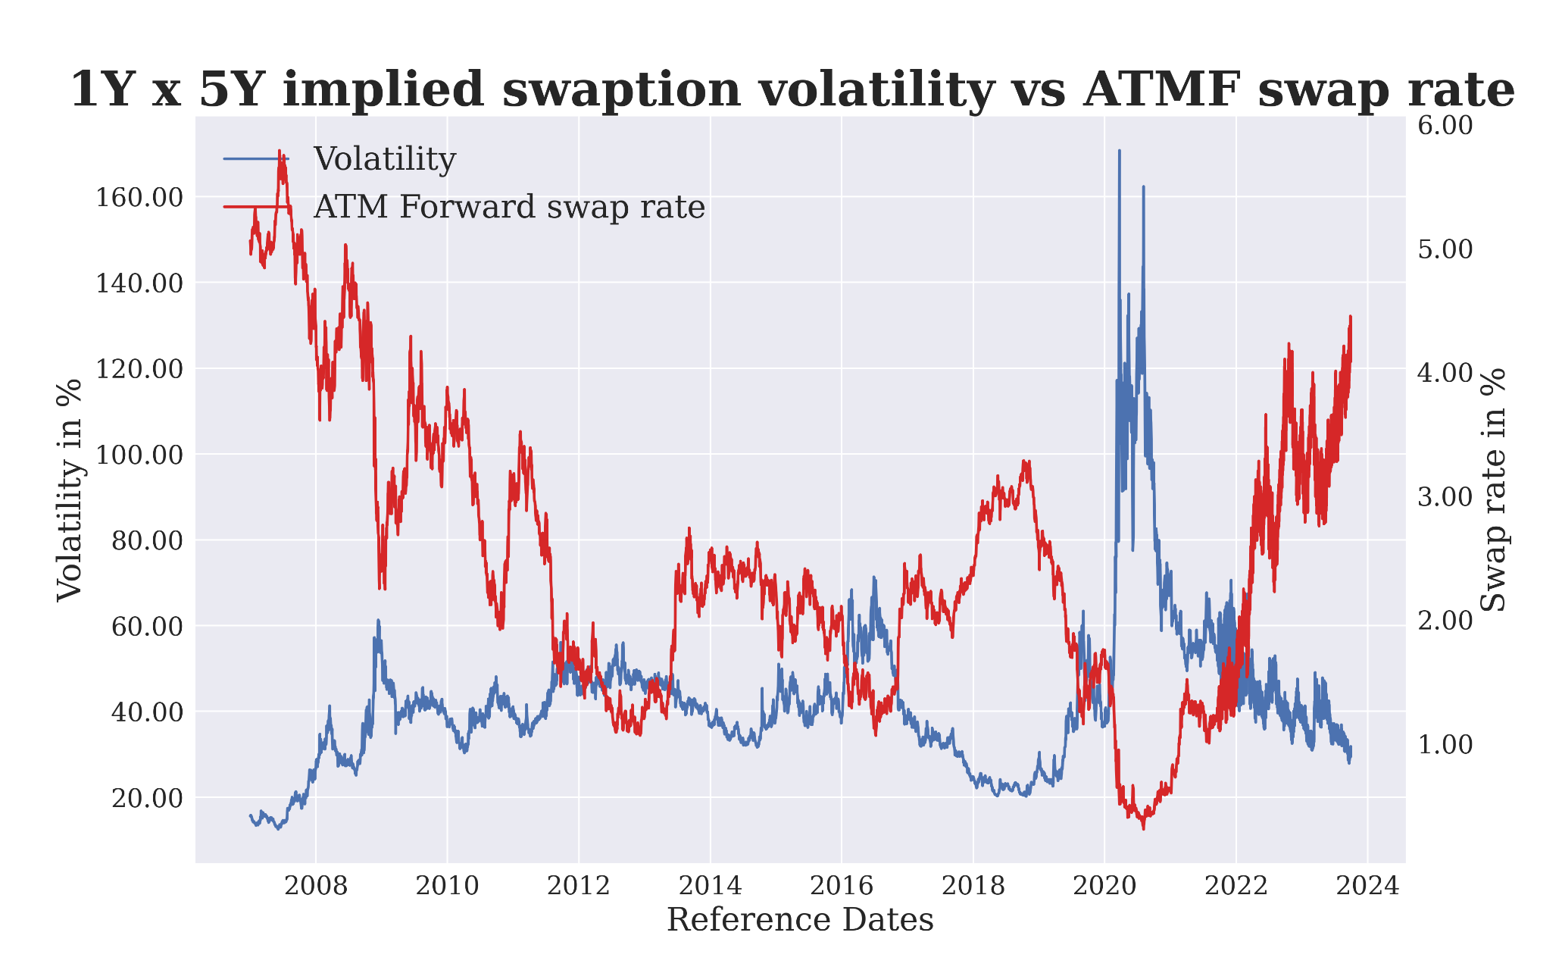
Predictive power…
Stylized facts about volatility (2)
Negative correlation between ATMF swap rates and implied European swaption volatilities is apparent
We can easily indetify major drivers of the move such as Lehmann’s collapse, financial crisis, quantitative easing, Brexit, Covid and post-pandemic inflation

Slide 11
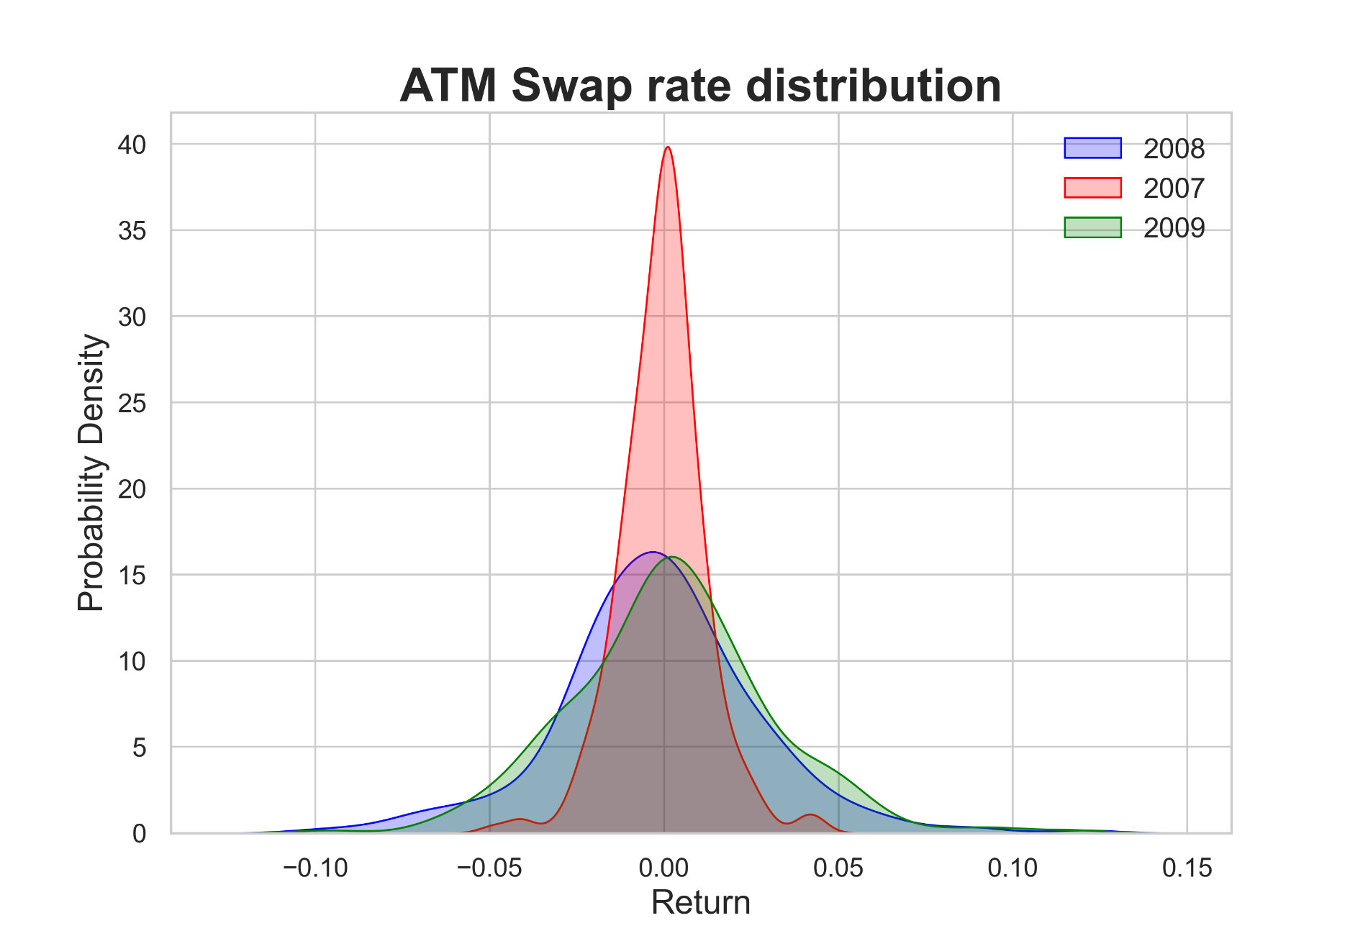
Predictive power…
Stylized facts about volatility (3)
Different shape of distributions imply changing volatility in time

Slide 12
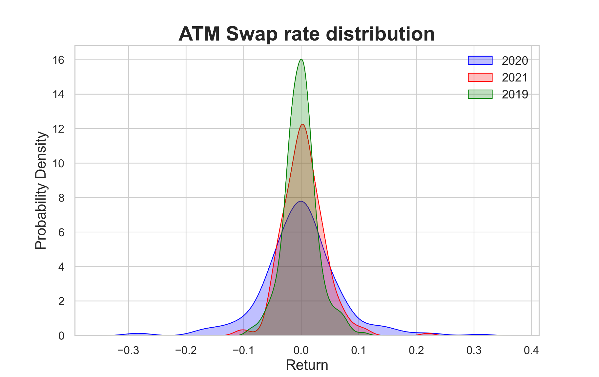
Predictive power…
Stylized facts about volatility (4)
Different shape of distributions imply changing volatility

Slide 13
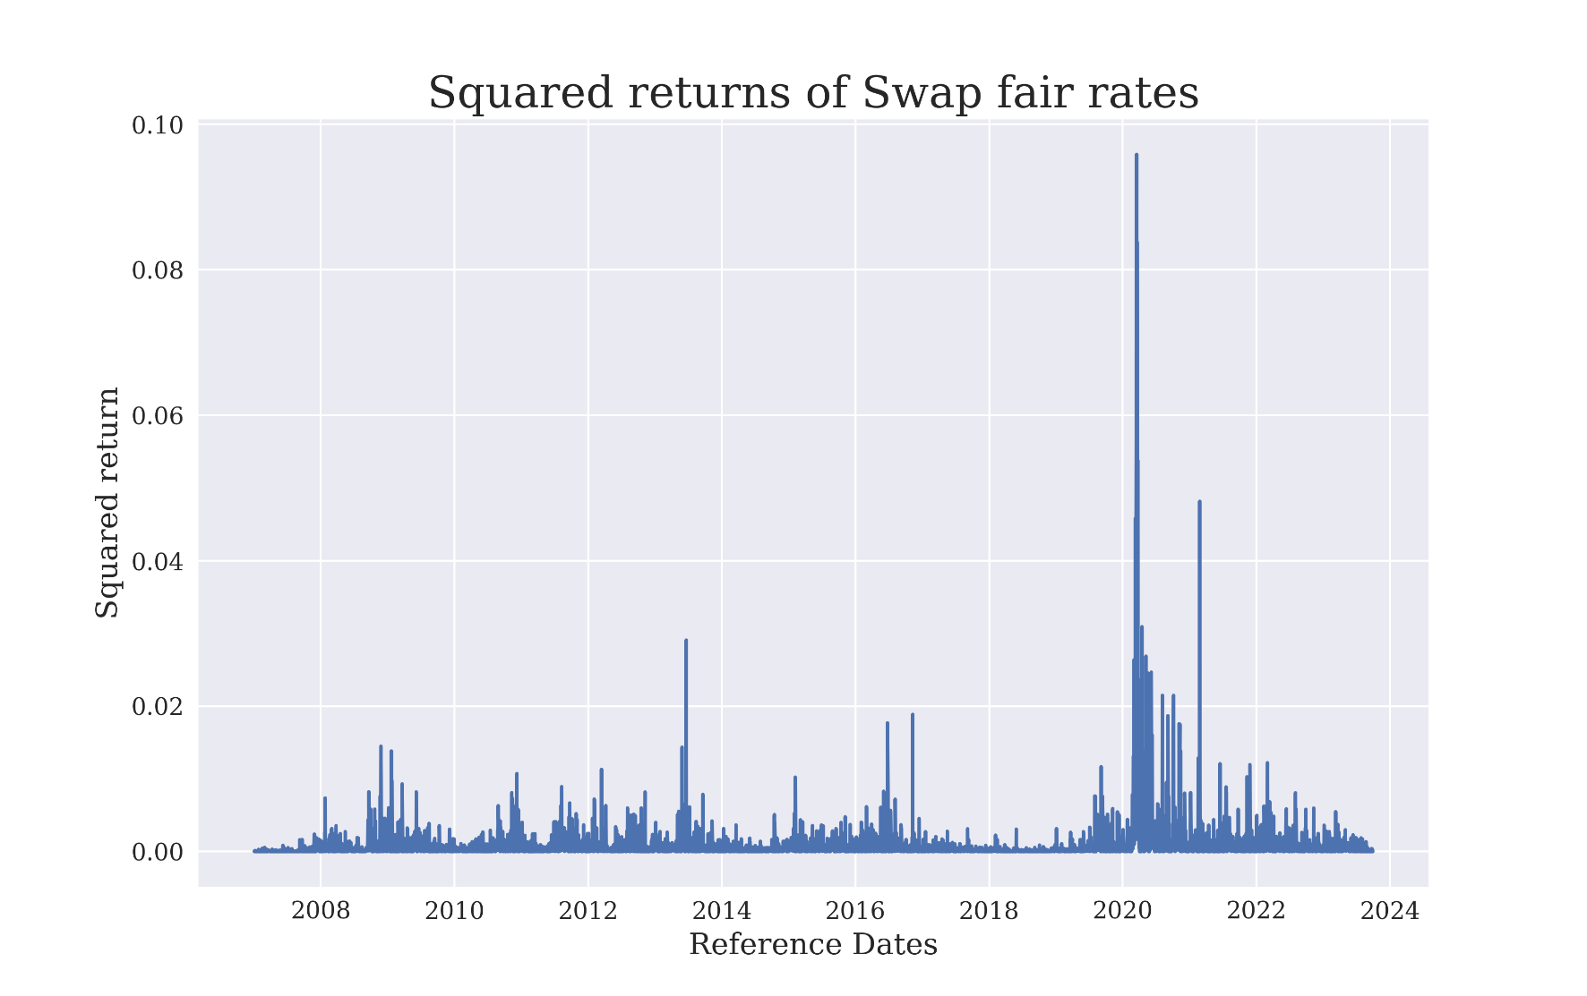
Predictive power…
Stylized facts about volatility (5)
Volatility clustering – a volatile period tends to be followed by another volatile period
Intuition says that markets need time to digest big news, hence volatility persists
Statistically, time varying conditional variance implies that big volatility today may lead to big volatility tommorrow

Slide 14
Predictive power of GARCH
03
GARCH model specifications

Slide 15
Predictive power …
GARCH model specifications (1)
Generalized Autoregressive Conditional Heteroscedasticity model (GARCH) reads:
$σ_{t}^{2}= ω+\sum_{i=1}^{p}{β_{i}σ_{t−i}^{2}+}$ $\sum_{j=1}^{q}{α_{i}ε_{t−j}^{2}} \left(2\right)$
Where current variance depends on:
past variances: $σ_{t−i}^{2}$
Square of past errors: $ε_{t−j}^{2}$

Slide 16
Predictive power …
GARCH model specifications (2)
In particular GARCH(1,1) model reads:
$$X_{t}=μ+ε_{t},where ε_{t}\sim N\left(0,σ_{t}^{2}\right) (3)$$
$$σ_{t}^{2}= ω+β_{1}σ_{t−1}^{2}+α_{1}ε_{t−1}^{2} (4)$$
Which is a natural extension of ARCH(1) :
$$X_{t}=μ+ε_{t},where ε_{t}\sim N\left(0,σ_{t}^{2}\right) (5)$$
$$σ_{t}^{2}= ω+α_{1}ε_{t−1}^{2} (6)$$

Slide 17
Predictive power …
GARCH model specifications (3)
Parameter $β_{1}$ measures persistance of conditional volatility irrespective of what is going on in the markets
Given large $β_{1}$ we can expect that volatiity takes a long time to die out after a turmbulent markets
The variance must me positive, therefore we need to impose restrictions on parameters i.e. $ω, β,α>0$
We also want to ensure that the process is stationary which implies $β+α<1$

Slide 18
Predictive power …
GARCH model specifications (4)
We can think of innovations $ε_{t}$ as the news that arrive to the market place and influence prices
A GARCH filter can be seen as un updating mechanism that depends on the size of these news
Model implies also the unconditional (long run) variance as:
${\overline{σ}}^{2}=\frac{ω}{1−β−α}$ (7)

Slide 19
Predictive power …
GARCH model specifications (5)
We finally write the variance process as :
$$σ_{t}^{2}=\left(1−β−α\right){\overline{σ}}^{2}+βσ_{t−1}^{2}+{αε}_{t−1}^{2} (8)$$
There are hence three forces that come into play:
Current variance $σ_{t−1}^{2}$ with weight $β$
News’ size $ε_{t−1}^{2}$ with weight $α$
Reversion to the lon run variance ${\overline{σ}}^{2}$ with weight $1−β−α$

Slide 20
Predictive power of GARCH
04
GJR GARCH model specification

Slide 21
Predictive power …
GJR GARCH model specifications (1)
GJR GARCH (1,1) (Glosten-Jagannathan-Runkle) model reads:
$$σ_{t}^{2}= ω+β_{1}σ_{t−1}^{2}+α_{1}ε_{t−1}^{2}+ γ1_{(ε_{t−1}<0)}ε_{t−1}^{2} \left(9\right)$$
Impact of $ε_{t−1}^{2}$on $σ_{t}^{2}$:
When $ε_{t−1}>0$ : $α_{1}$
When $ε_{t−1}< 0$ : $α_{1}+$ $γ$

Slide 22
Predictive power …
GJR GARCH model specifications (2)
Restrictions on parameters to assure that variance is positive:
$ω, α_{1}, β_{1}>0$
$γ_{1}>−α_{1}$
$α_{1}+β_{1}<1$ and $α_{1}+β_{1}+γ_{1}<1$
$γ$describes asymmetric effect (leverage effect)

Slide 23
Predictive power …
GJR GARCH model specifications (3)
Impact of $ε_{t−1}^{2}$on $σ_{t}^{2}$:
Leverage effect:
$γ=0→symmetric effect$
$γ>0→negative innovations are more destabilizing than positive ones$
$γ<0→positive innovations are more destabilizing than negative ones$

Slide 24
Predictive power of GARCH
05
Calibration

Slide 25
Predictive power …
Calibration (1) - Specifaction
We are interested in implementing a Maximum Likelihood approach to estimate our model
Given a series ${\left\{X_{t}\right\}}_{t=1}^{T}$we are interested in the conditional density (or likelihood)
$$M(X_{t}|θ)=f(X_{t}|G_{t−1},θ)$$
$θ$ is a vector of model parameters and $G_{t−1}$ stands for all information available at time t -1 , i.e.: $G_{t−1}=\left\{X_{t−1}, X_{t−2}, …\right\}$
The log-likelihood of the series, which is maximized with respect to $θ$, is just the sum:

Slide 26
Predictive power …
Calibration (2) - Specifaction
$$M=\sum_{t=1}^{T}{\log{f\left(X_{t} | θ\right)} }$$
Where:
$$f\left(X_{t} | θ\right) = \frac{1}{\sqrt{2πσ^{2}}}e^{−\frac{{(x−μ)}^{2}}{2σ^{2}}}$$

Slide 27
Predictive power …
Calibration (3) - Results
GARCH (With Matlab):

Slide 28
Predictive power …
Calibration (4) - Results
GJR -GARCH (With Matlab):

Slide 29
Predictive power of GARCH
06
Testing the models

Slide 30
Predictive power …
Testing the model (1)
In the first place we want to test whether there is a GARCH effect. So we are testing a series of ATMF swap rates for a swap that starts in 1Y and matures in 5Y
We plot ACF (Autocorrelation Function ) and PACF (Partial Autocorrelation Function) of squared residuals
Finally we perform Engel ARCH test, with null hypothesis stating that there is no heteroscedasticity effect in data
Using Matlab the following results were achieved:

Slide 31
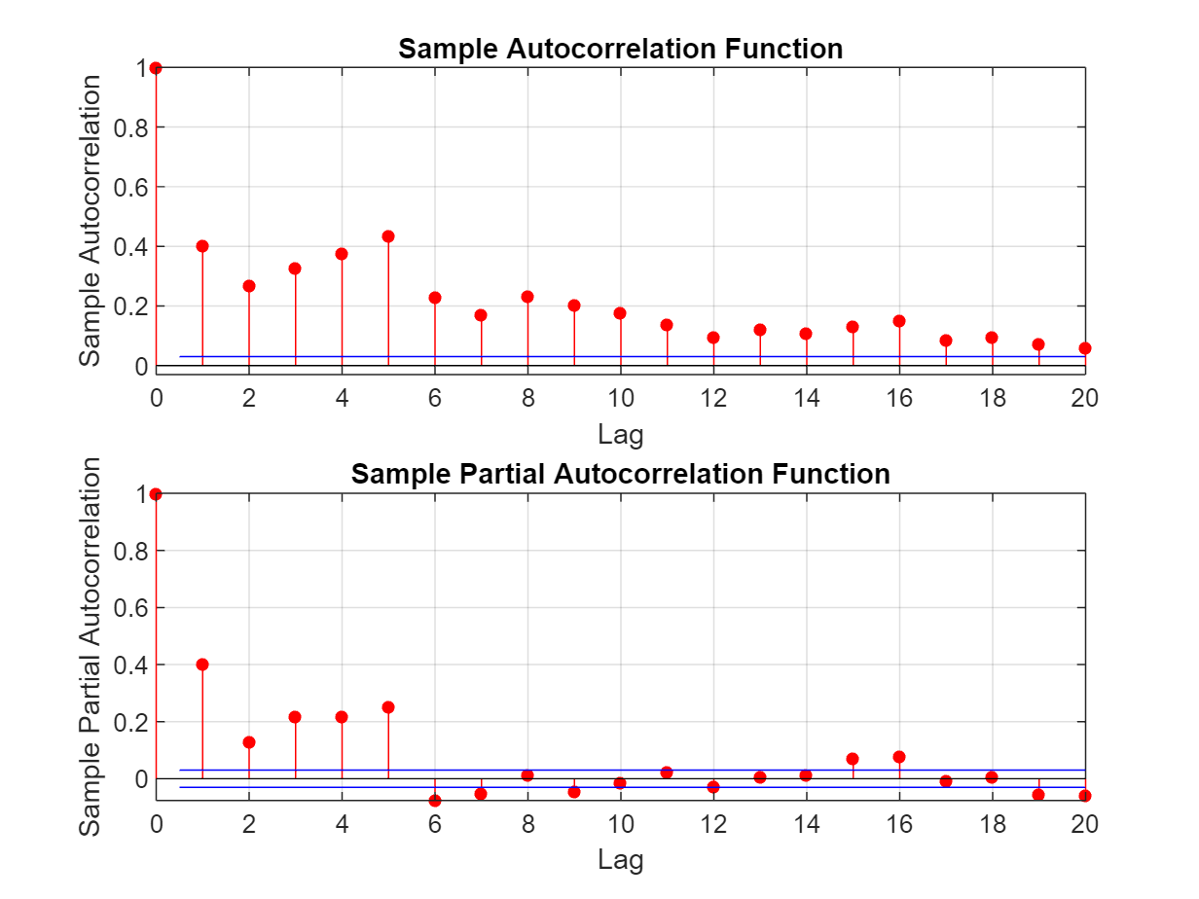
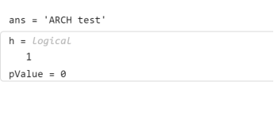
Predictive power …
Testing the model (2)
Analysis points to the strong autocorrelation in data and thus existence of GARCH effect

Slide 32
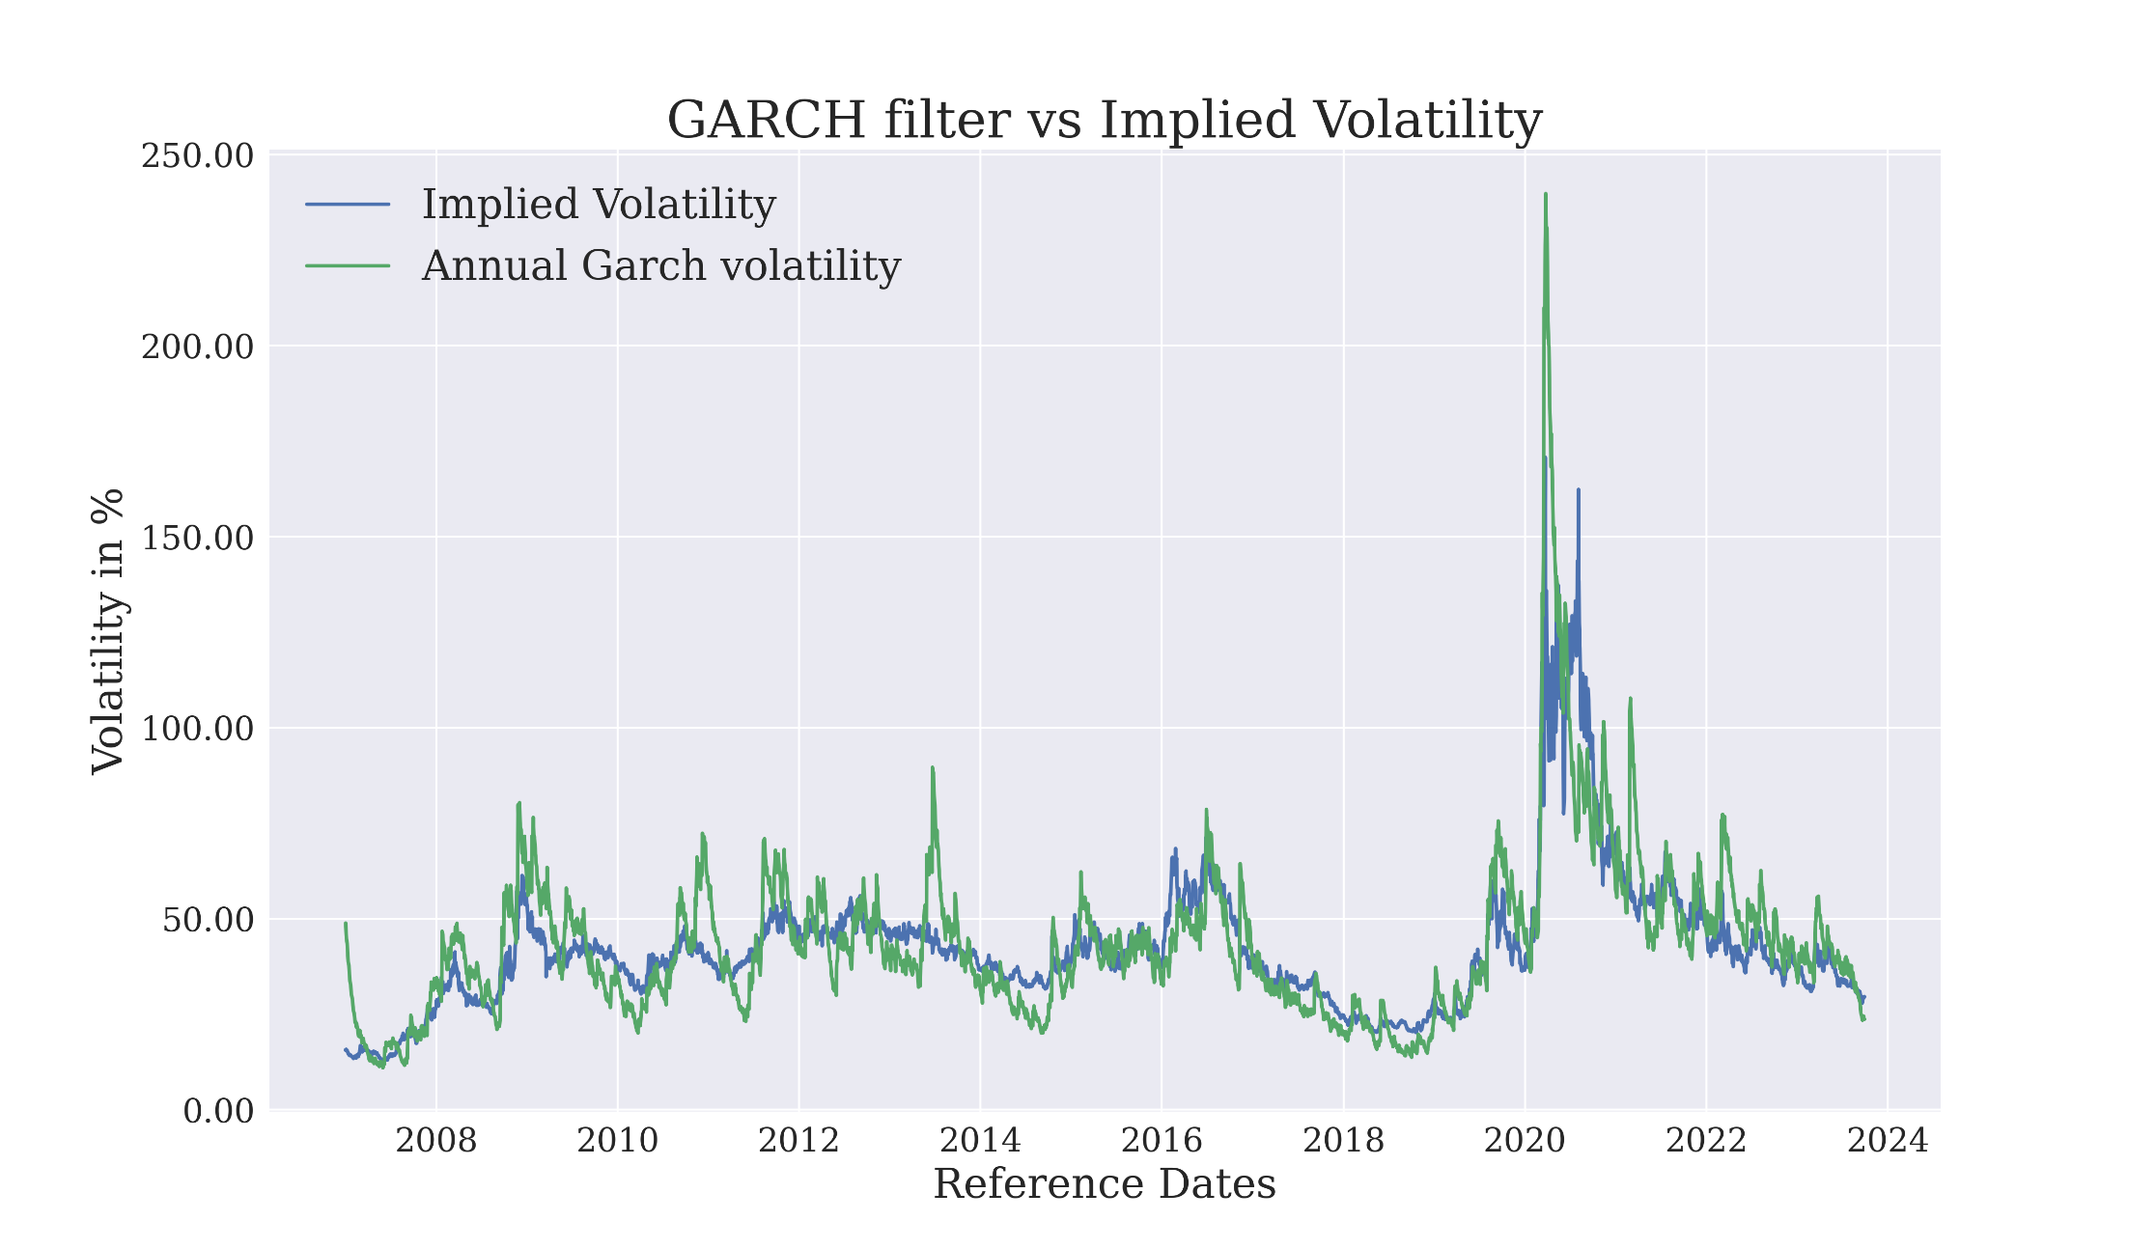
Predictive power …
Testing the GARCH model (3)
GARCH filter follows implied volatility closely
Sometimes overshoots subtantially and variance is more volatile
Apparently captures stylized facts well
It would be interesting to see how it performs with respect to other asset classes and instruments in turbulent times

Slide 33
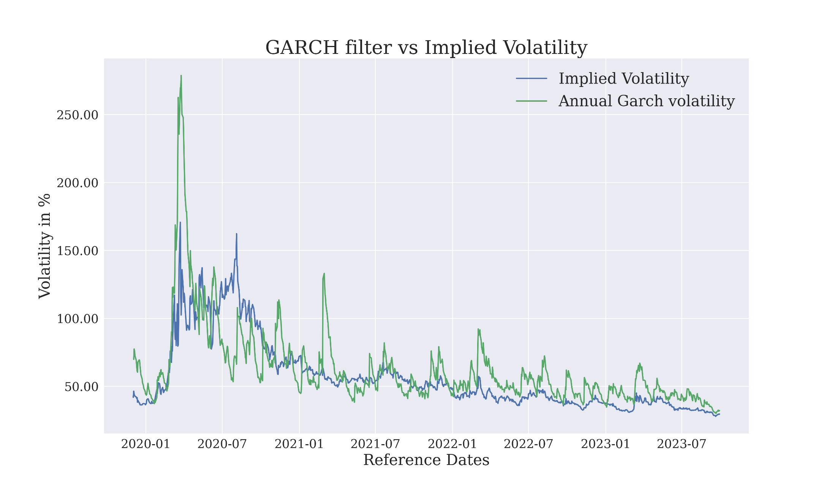
Predictive power …
Testing the GARCH model (4) – SOFR collateralization
With SOFR discounting for most recent 3 years we see similar behavior
GARCH volatilities track well implied ones
GARCH volatilities seem to be more volatile

Slide 34
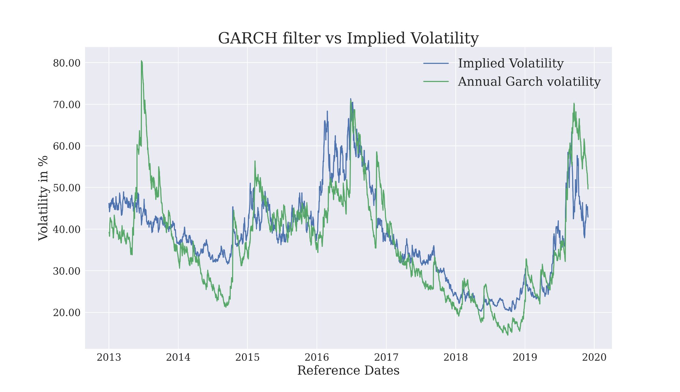
Predictive power …
Testing the GARCH model (4) – OIS collateralization
With OIS discounting replication seems to be even closer
GARCH volatilities overshoot implied ones in few cases

Slide 35
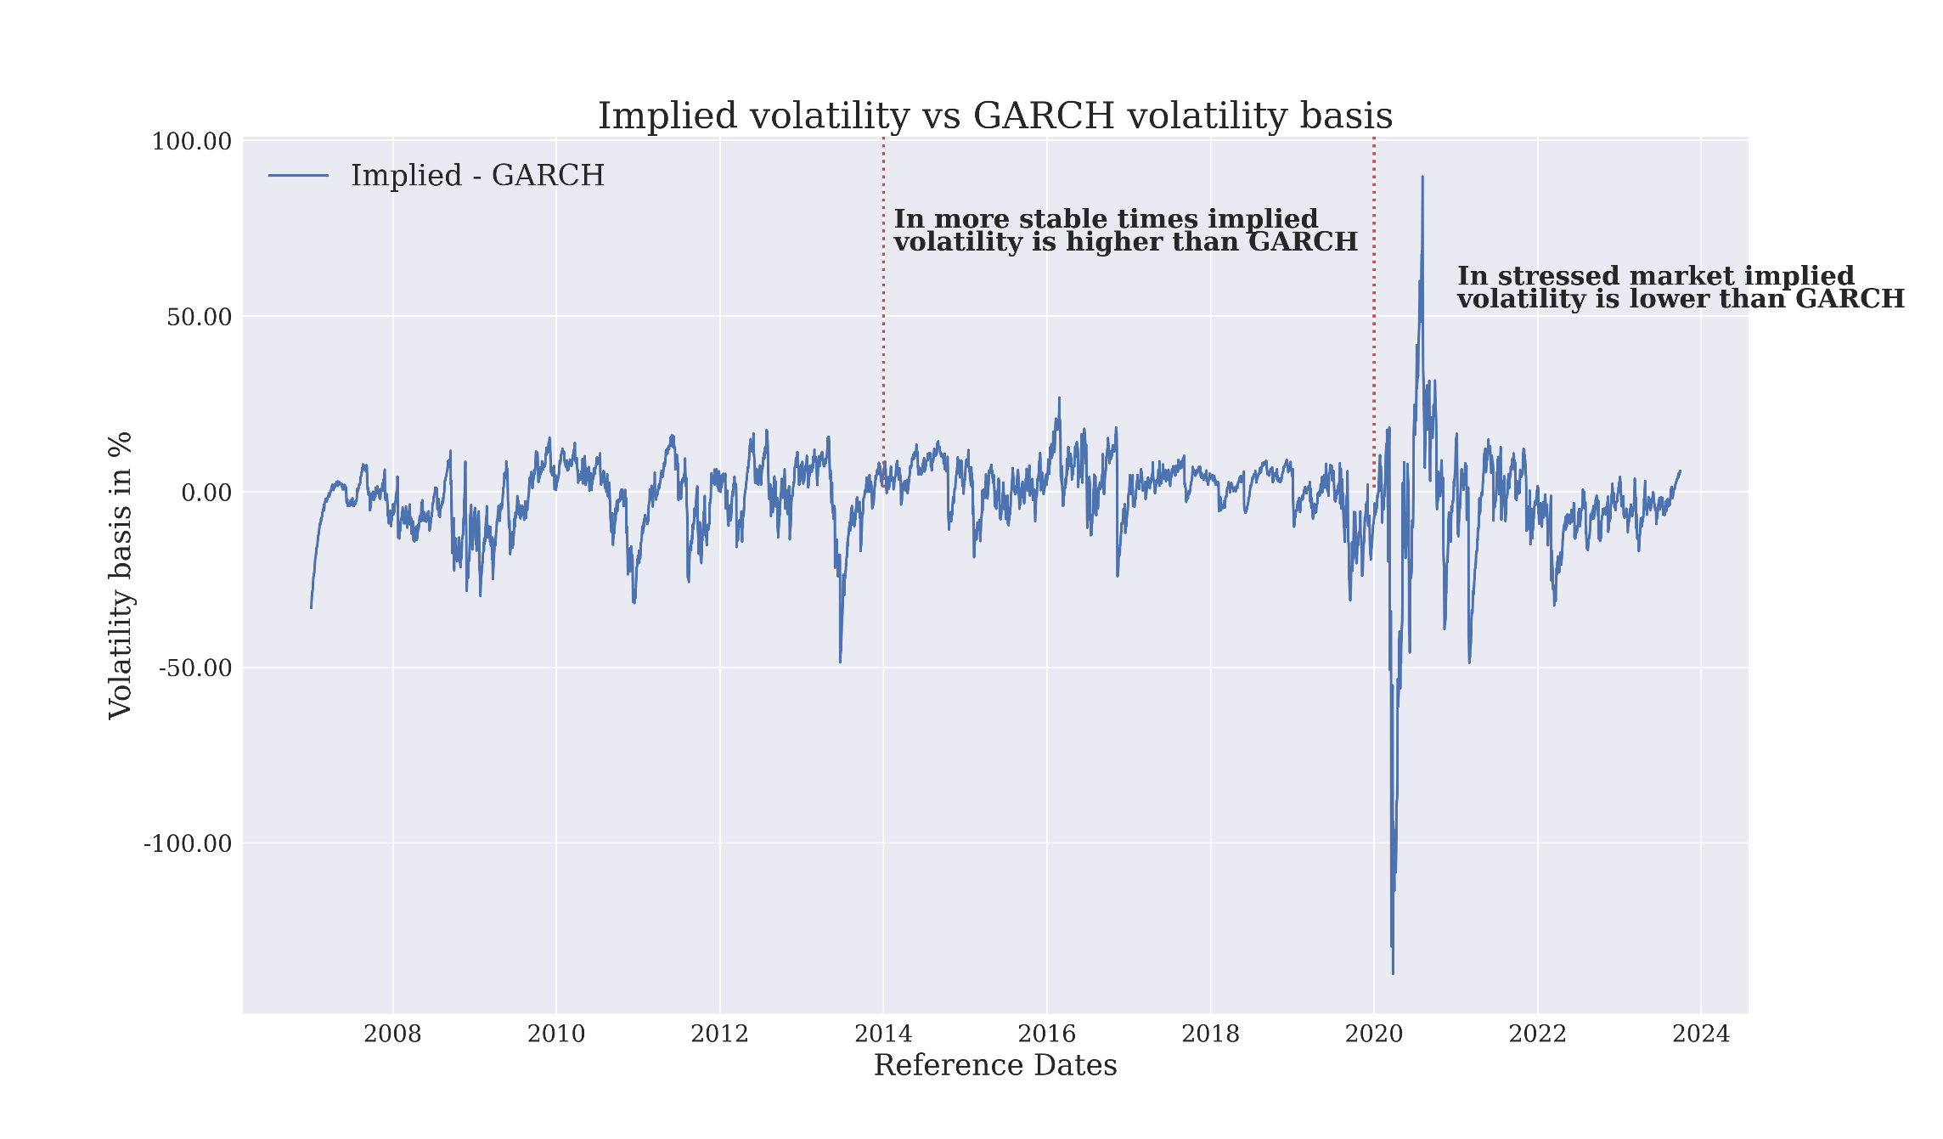
Predictive power …
Testing the GARCH model (5) – Basis

Slide 36
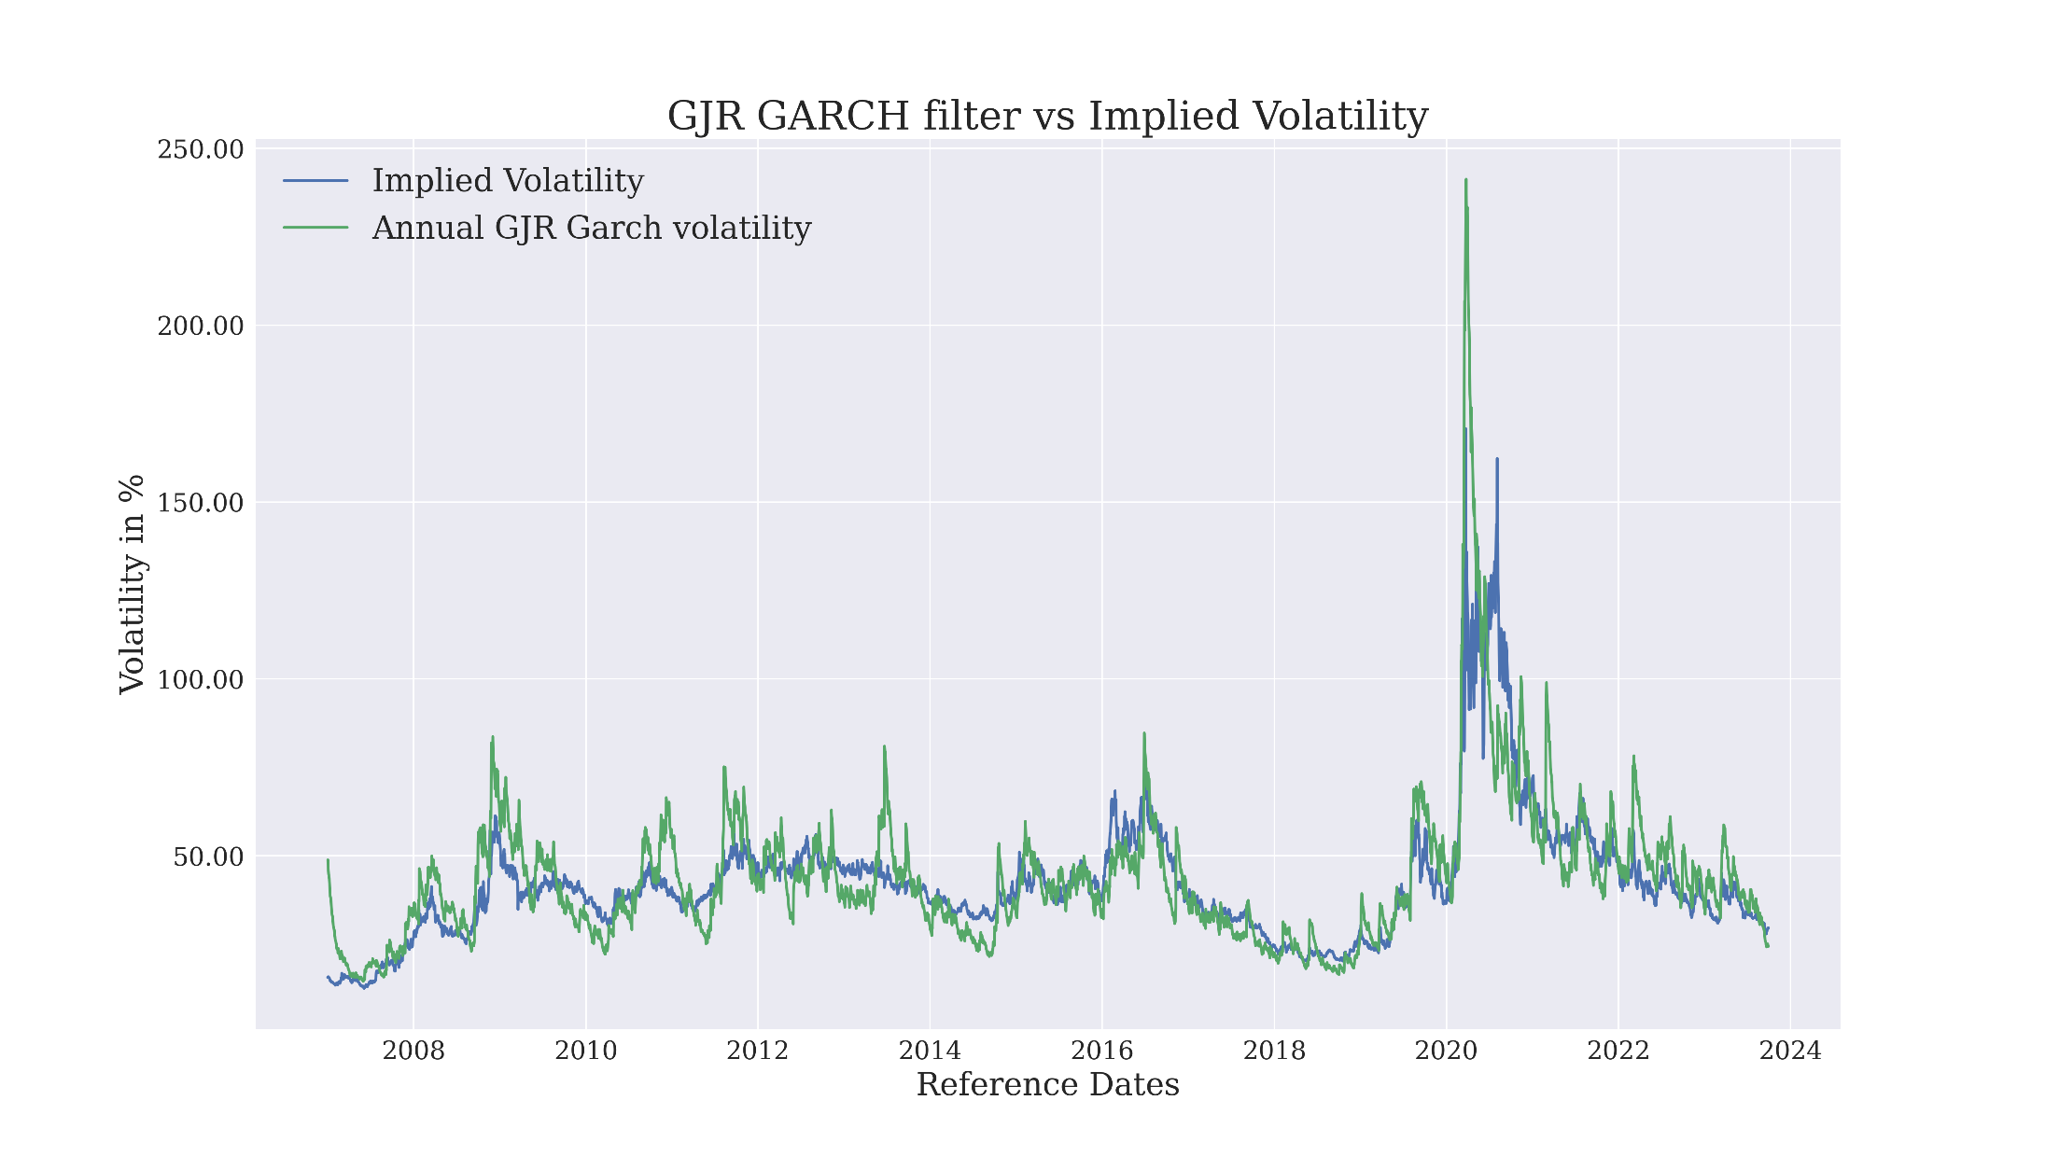
Predictive power …
Testing the GJR - GARCH model (6)
GJR GARCH filter follows closely implied swaption volatility
Regular GARCH has higher variance of volatilities than GJR.

Slide 37
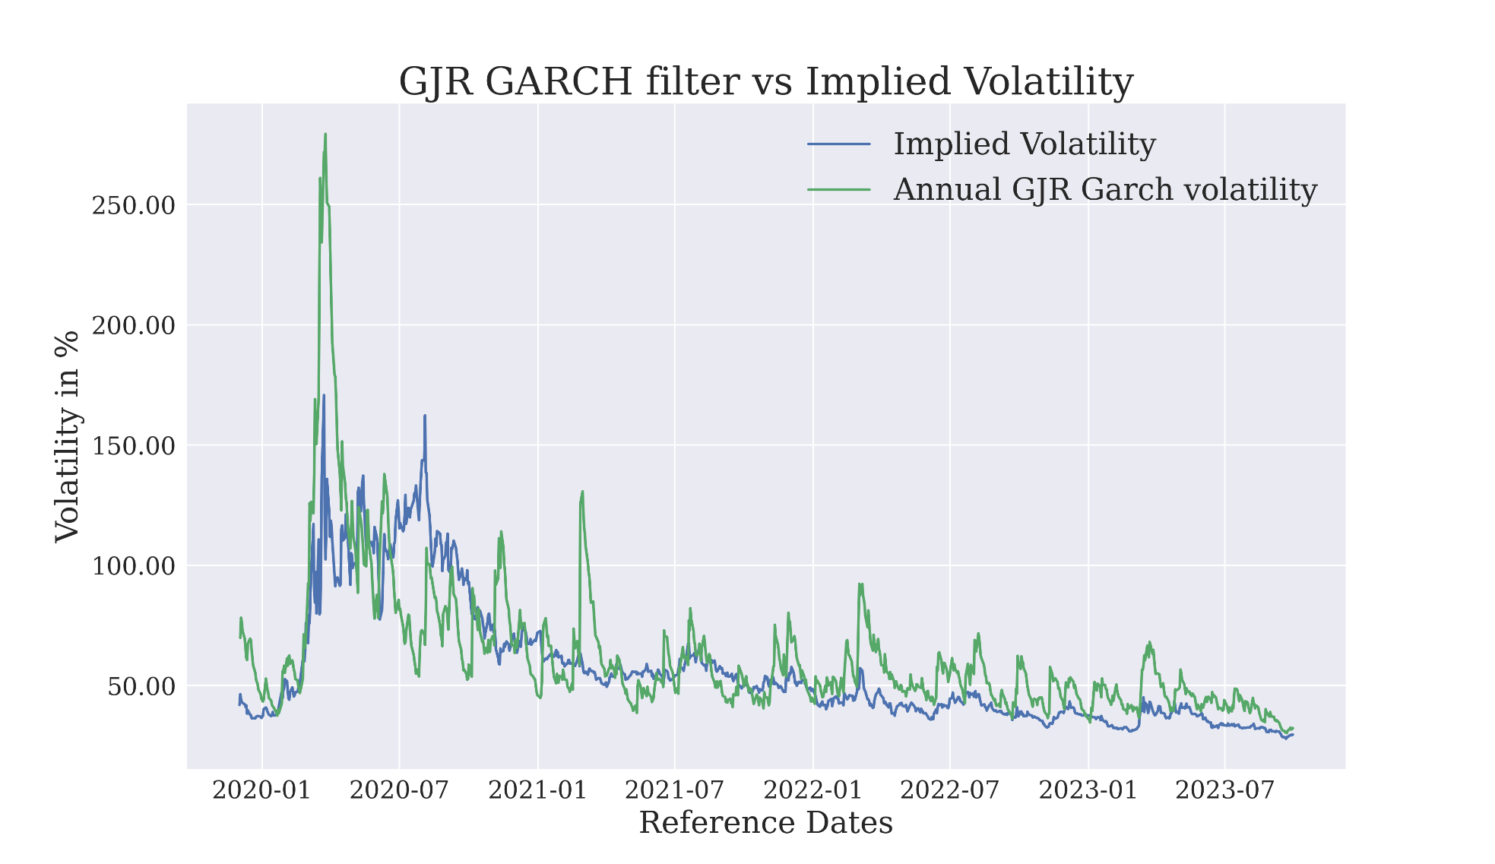
Predictive power …
Testing the GJR - GARCH model (7) – SOFR collateralization
GJR GARCH filter follows closely implied swaption volatility
GJR GARCH implies slightly higher varaince of volatilities than regukar GARCH

Slide 38
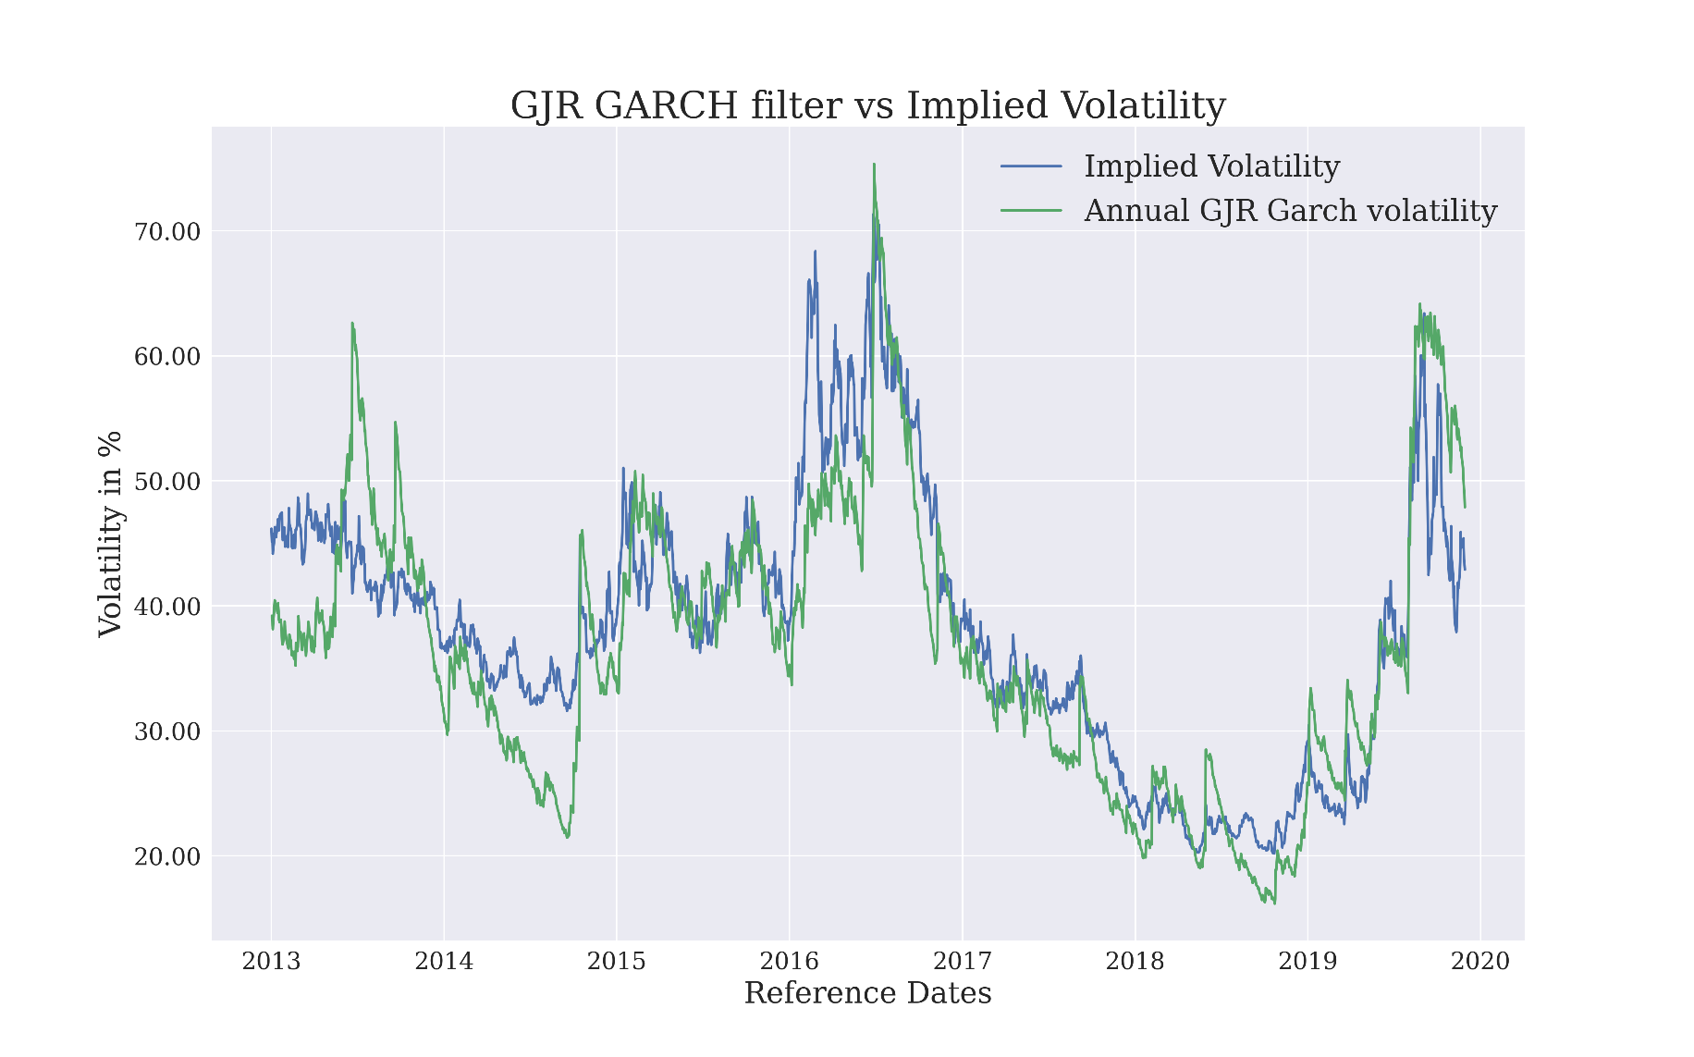
Predictive power …
Testing the GJR - GARCH model (8) – OIS collateralization
GJR GARCH filter follows closely implied swaption volatility
GJR GARCH filter has smaller variance than regular GARCH

Slide 39
Predictive power …
Testing the GJR - GARCH model (9) – OIS collateralization

Slide 40
Predictive power of GARCH
07
Note on convergence

Slide 41
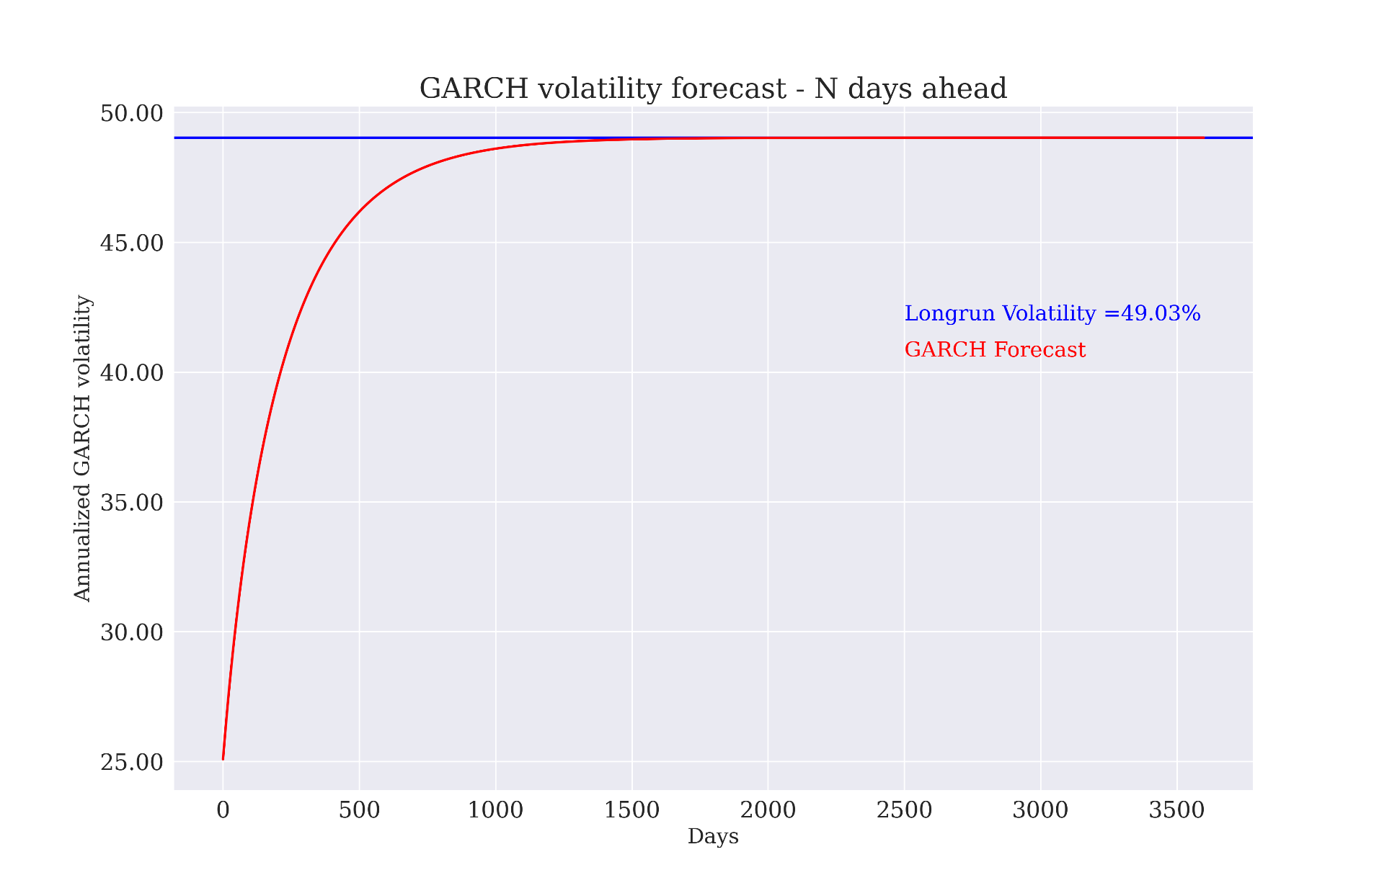
Predictive power …
Note on convergence (1) – GARCH model
GARCH model annualized volatility converges to long run within 3 years

Slide 42
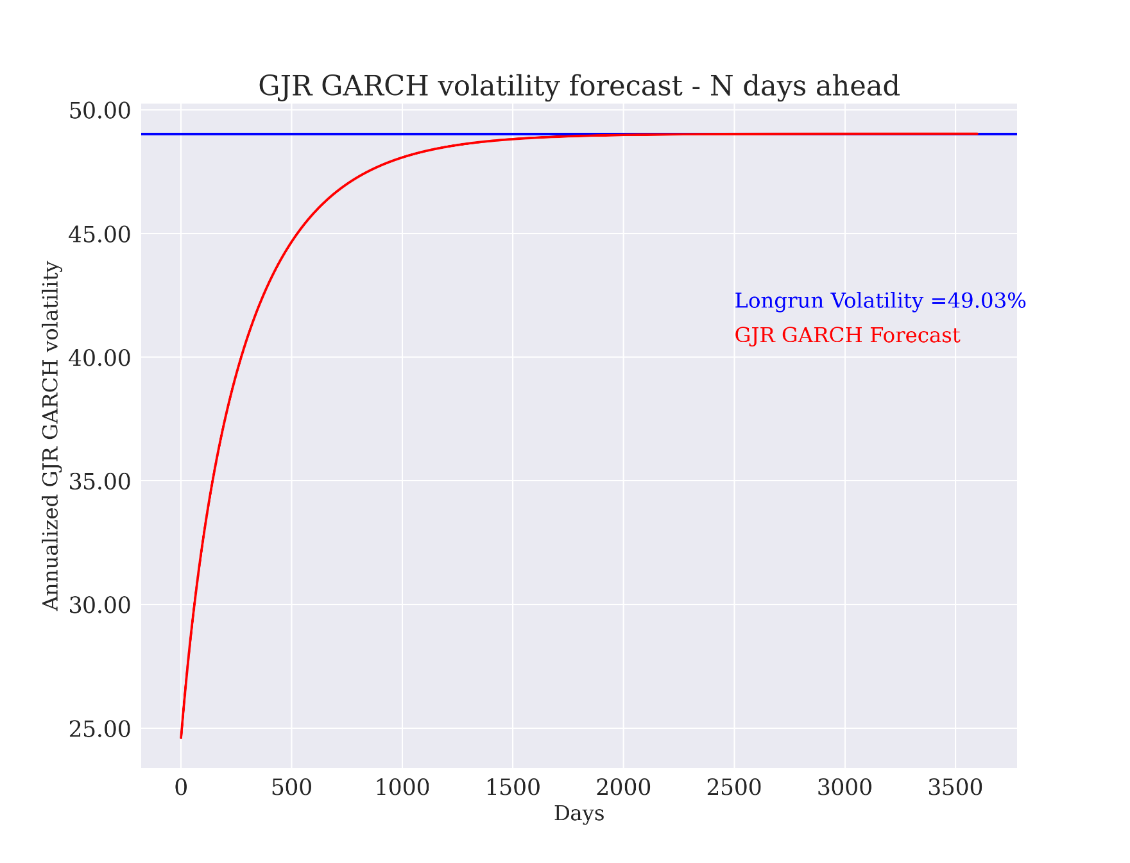
Predictive power …
Note on convergence (2) – GJR GARCH model
… similarly GJR GARCH

Slide 43
Predictive power …
08
Backtesting

Slide 44
Predictive power …
Backtesting (1) - Procedure
We define set of data to train the model
Next we define set of data to test the model
We iteratively calibrate the model
With calibrated parameters we calculate one day variance forecast
Next we define 95% Projection interval defined as mean +/- 1.96 * sqrt(projected variance)
The closer the number of realized returns which falls into projection interval to 95% the better model specification

Slide 45
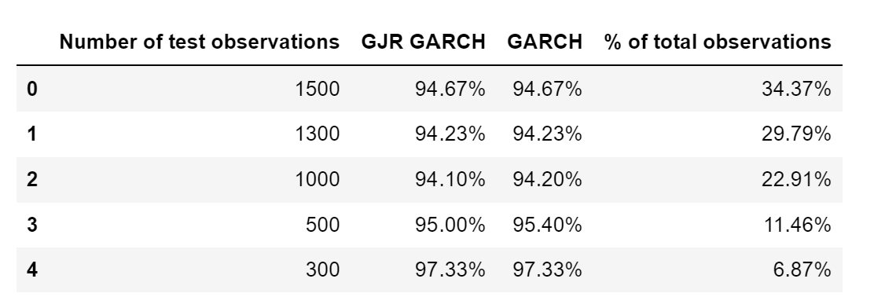
Predictive power …
Backtesting (2) - Results
There are 4364 observations in total
Matlab code has been used to produce the results:

Slide 46
Predictive power …
Backtesting (3) - Conclusions
Both models show satisfactory results implying good specification
No actual difference between them

Slide 47
Predictive power …
09
Some remarks on total variance

Slide 48
Predictive power …
Some remarks on total variance (1)
The analysis so far used ATM swaption volatility only as a point of reference for GARCH filtration, ignoring smile and skew
In order to capture the total maket variance we decided to examine how GARCH captures fair strike of a Variance Swap
We started with leveraging SRVIX, that used to be quoted at the CBOT (is not any more)

Slide 49
Predictive power …
Some remarks on total variance (2)
According to the CBOT SRVIX write-up document the quotes index reads:
${SRVIX}_{t}\left(M,T\right)= {100}^{2 }\sqrt{\frac{2}{{PVPB}_{t}}\left(\sum_{i:K_{i}<R_{t}}{{SW}_{t}^{R}\left(K_{i},M,T\right)∆K_{i}+\sum_{i:K_{i}≥R_{t}}{{SW}_{t}^{P}\left(K_{i},M,T\right)∆K_{i}+}}\right)},$
Where: $t −time of calulation,$ $M−swaption maturity,$ $T−swap tenor,$ $R_{t} −ATMF swap rate,$ ${PVBP}_{t} −price value of basis point, swap annuity,$ ${SW}_{t}^{R}−price of corresponding receiver swaption,$ ${SW}_{t}^{P}−price of correspondig payer swaption,$ $K_{i}−highest OTM strike available,$ $∆K_{i}−strike increment$

Slide 50
Predictive power …
Some remarks on total variance (3)
CBOT formula covers discrete and small numer of swaptions i.e. 11 whereas variance swap assumes continuum of swaptions, hence we tested both aproaches:
With 1000 swaptions, 500 receivers and 500 payers, with volatilities implied by calibrated SABR
With predefined strikes according to CBOT guidelines and volatilities read off the surface

Slide 51
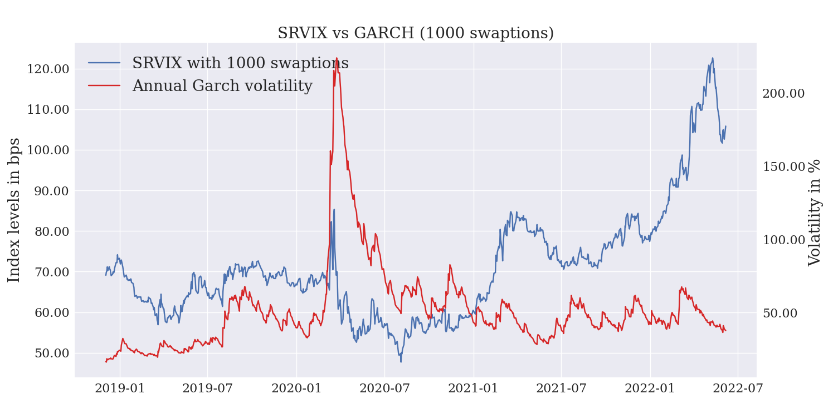
Predictive power …
Some remarks on total variance (4)
With 1000 swaptions:

Slide 52
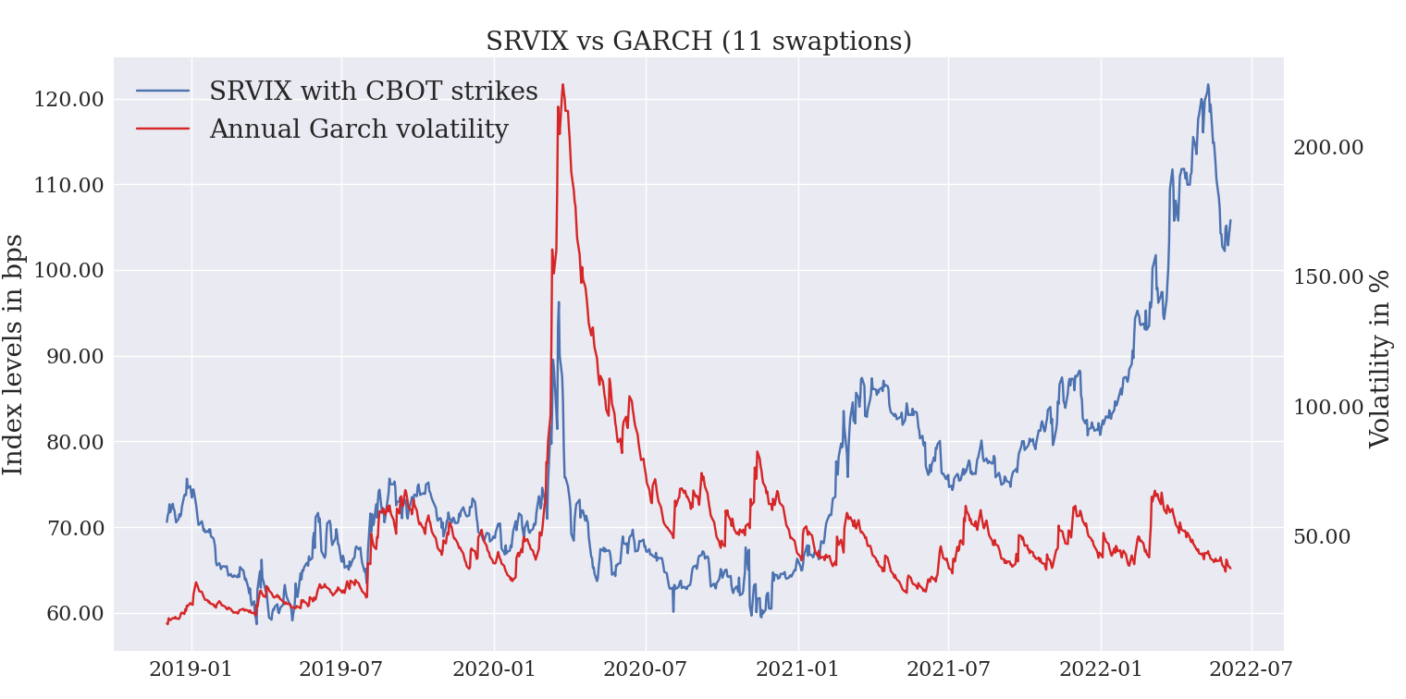
Predictive power …
Some remarks on total variance (5)
With predefined strikes:

Slide 53
Predictive power …
Some remarks on total variance (6)
With predefined strikes:

Slide 54
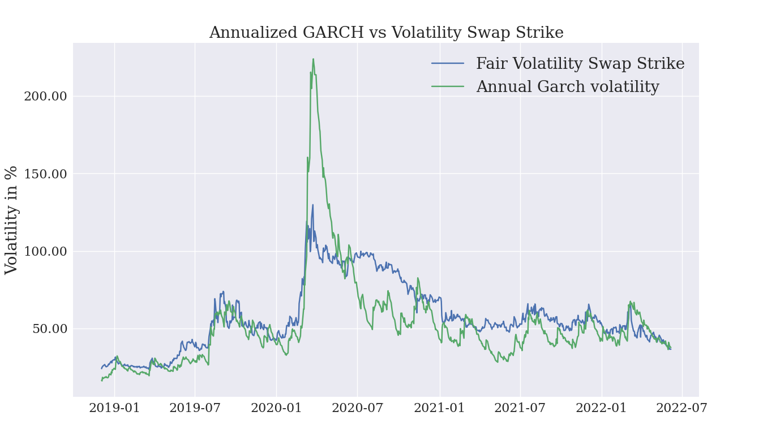
Predictive power …
Some remarks on total variance (7)
Finally with adittional scaling by inverse of squared strike:

Slide 55
Predictive power …
Some remarks on total variance (8)
More details on total variance replication cound be found in Carr Madan (2002)
Analysis shows that GARCH filter captures also Total Market Variance

Slide 56
Predictive power…
10
Final conclusions

Slide 57
Predictive power …
Final conclusions
Both GARCH models are able to capture volatility common features
Back testing show satisfactory resutts pointing to good model specification
In case of swap rates used for the analysis (1X5) no actual difference between GARCH and GJR GARCH, pointing to no strong leverge effect
GARCH lends itself well for volatility projection (including total market variance) and Value-at-Risk calculations

Slide 58
Predictive power…
10
THANK YOU FOR YOUR ATTENTION!!!
IT’S TIME FOR Q&A

Slide 59
Disclaimers & Disclosures
The views expressed within this material are those of the contributors and not necessarily those of BNY Mellon. This material does not constitute a recommendation by BNY Mellon of any kind. The information herein is not intended to provide tax, legal, investment, accounting, financial or other professional advice on any matter, and should not be used or relied upon as such. BNY Mellon has not independently verified the information contained in this material and makes no representation as to the accuracy, completeness, timeliness, merchantability or fitness for a specific purpose of the information provided in this material. BNY Mellon assumes no direct or consequential liability for any errors in or reliance upon this material.

